Slide 1
CODE MODERNIZATION PROPOSAL Overview for Community Meetings
Updating the Permit Processing Framework
Agricultural Regulations
Wineries and Breweries
Temporary uses and structures
Limits to weddings on residential property
Revisions to site standards for multi-family zone district
Revisions to permit process for accessory structures

Slide 2
Structure of the Presentation
Overview of Draft Code Modernization Proposal
Detailed review of proposal for updating agricultural regulations
Handouts and sign-in sheet available
Questions as we go
Next steps

Slide 3
Why Update Land Use Regulations?
Overview
Difficulties for individual permit applicants:
Confusing and complicated permit framework with different interpretations
Expensive and lengthy permit reviews with uncertain outcomes
Outdated regulations for agricultural properties
Unnecessarily complex permit process for some projects, e.g.:
Small agricultural greenhouse, new commercial tenant
Resulting in difficulties for the community:
Widespread illegal construction that may be unsafe, or may not comply with site standards or environmental regulations
Lack of community investment - housing and jobs
Goals: Straightforward regulations that all can be understood by all, with complete, consistent and efficient review of applications.
Revise outdated regulations
Continue to protect the environment and the quality of neighborhoods.

Slide 4
What is Code Modernization?
Overview
Update Permit Administration- Modernize and Standardize the Permit framework, use clear nomenclature
Update regulations for agricultural uses to support local commercial agriculture, breweries and wineries, while preserving ag. land
Update list of uses allowed in zone districts, with appropriate reviews for different project types
Add language lacking in current code to regulate:
Limit commercial weddings on residential property
Community events
Newer types of temporary structures, such as PODS
Revisions to site standards for the Multi-family zone district and to permit requirements for residential accessory structures
Maintain regulations protecting the environment and neighborhood quality

Slide 5
Code Modernization: Development of the draft proposal
Board of Supervisors Initiates Code Modernization Proposal
2014- 2015 – Review of Proposal by APAC, Board of Supervisors
Sept. 29: Board of Supervisors Meeting
Board directs Planning Department to revise proposal to reflect community feedback, hold an additional public meeting in South County, and begin an Environmental Impact Report
NEXT STEPS: 2016
Prepare EIR on Modernization Proposal
Public meetings and hearings on Draft EIR and Code Modernization with other topics
September 2015: COMMUNITY MEETINGS
Discussion and Feedback on Code Modernization Proposal

Slide 6
Permit Processing Framework Chapter 18.10
Introduce separate permits for uses (“Use permit”) and physical site development (“Site development permit”)
Use standard, descriptive terms for permits and processes (e.g. “Conditional Use Permit”, “Minor Site Development permit”)
Clarify which permits are subject to environmental review (“discretionary” vs. “ministerial”)
Update uses allowed in zone districts to include modern uses, such as research and development in commercial zones

Slide 7
New Permit Terms
Permit | Public Notice | Decision Maker
Zoning Clearance (ZC) | No | Planning Director
Minor Use Permit (MUP) | No | Planning Director
Administrative Use Permit (AUP) | Yes | Planning Director
Conditional Use Permit (CUP) | Yes | Public Hearing

Slide 8
PERMIT NAMES, CURRENT AND PROPOSED
PERMIT DECISIONS BY PLANNING DIRECTOR OR DESIGNATED STAFF
Current Code | Permit Name In Proposed Code | Type of Action | Public Notice | Public Hearing | Who Decides Appeals, Who May Appeal
Level I, Level II | Zoning Clearance (ZC) Environmental Clearance (EC) | Ministerial | No | No | Planning Director, Applicant / Owner
Level III | Minor Permit MUP, MSP | Discretionary | No | No | Zoning Administrator, Any party
Level IV | Administrative Permit AUP, ASP | Discretionary | Yes | No | Zoning Administrator, Any party
PERMIT DECISIONS BY ZONING ADMINISTRATOR
Level V | Conditional Permit CUP, CSP | Discretionary | Yes | Yes | Planning Commission, Any party
PERMIT DECISIONS BY PLANNING COMMISSION
Level VI | Conditional Permit CUP, CSP | Discretionary | Yes | Yes | Board of Supervisors (jurisdictional hearing), Any party
PERMIT DECISIONS BY BOARD OF SUPERVISORS
Level VII | Tentative Maps Legislative Matters | Discretionary | Yes | Yes | No Appeal (Court challenge is next step)

Slide 9
Update Policies to Support Local Agriculture
Agriculture
Update policies to support diverse needs of local agriculture, from small diversified farms to large farming operations spread over multiple parcels, as identified in meetings with Farm Bureau, APAC
Protect agricultural land and the viability of commercial agriculture consistent with Measure J
Accommodate the need for more agricultural support infrastructure such as agricultural research and development, as identified in the 2014 Economic Vitality Study
Recognize that activities such as on-farm retail and agricultural services (equipment repair, delivering agricultural products, and equipment storage) are needed to support the basic farm activities of producing food, fiber and livestock, and are part of agriculture use sector
Support agricultural employee housing consistent with state law
s

Slide 10
Proposal Implements “Measure J” Policies
Agriculture
Text from Measure J (SCCC Chapter 17.01, Growth Management)
Findings. “Loss of Agricultural Lands…. These agricultural lands are being lost to development, and the continued viability of commercial agriculture in Santa Cruz County is threatened by rapid population growth and inappropriately placed development.”
Policies. “Preserve Agricultural Lands. It shall be the policy of Santa Cruz County that prime agricultural lands and lands which are economically productive when used for agriculture shall be preserved for agricultural use.”
Agricultural update implements Measure J:
Updated regulations support viability of local agriculture, as identified by the Farm Bureau
Maintains existing restrictions against converting agricultural land to other uses (residential or commercial) to protect farmland
Continues to prohibit subdivisions on CA land for non–agricultural purposes
Preserves agricultural land thru siting requirements, discretionary permits

Slide 11
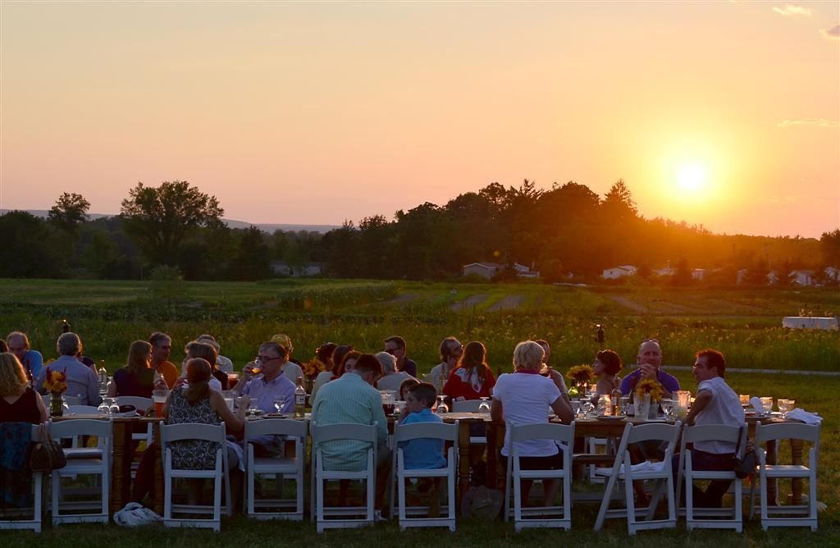
Modern Uses Added In Agricultural Districts
Agriculture
Agritourism and Education (farm dinners, school visits, farm to table)
Produce markets (requires discretionary permit, local inventory requirement, and size limit)
Farmstay/Homestay (up to 6 guest rooms in residential buildings that are already allowed in code, use permit, criteria to prevent “motels”)
Research and Development (ancillary to farming on CA, subject to discretionary permit over 2,500 sq ft, criteria to minimize disturbance and protect type I-III soil)

Slide 12
Housing for Agricultural Employees
Meet community need for safe and affordable housing for farmworkers in agricultural areas
Incorporate State law that requires housing for agricultural employees to be treated as an agricultural use - up to 12 units/36 beds allowed “by right”.
Permit required for siting, and buffer required to adjacent agricultural parcels, to protect agricultural land and adjacent agricultural uses.
Allow Consideration of > 12 units/ 36 beds, subject to use permit and CEQA Review
Subject to Planning Commission public hearing, siting criteria, and limits on project size as needed to protect agricultural soils
Considered an agricultural use – not subject to residential standards specifying a minimum land area per unit

Slide 13
Additional Updates for Agriculture
Agriculture
Allow Accessory Dwelling Units on CA and A “by right”, as allowed throughout the County where there is a principal single family home
Broaden the agricultural services and support activities allowed on CA and A, such as farm equipment repair, subject to discretionary permits and CEQA review, with criteria and findings to protect agricultural land, such as:
Avoiding/minimizing disturbance of Type l-lll soil
Alternatives siting analysis for larger projects
Clustered development required
Simplify greenhouse regulations

Slide 14
Wineries And Breweries
Wineries
Issue with Current regulations:
Lack of standards for wineries, especially for tastings and events, leads to varying outcomes.
Standards for wine tastings are difficult to enforce.
Goals of revised regulations:
Provide standards in code to support local wineries and breweries, allow on-site marketing necessary to many local operations
Protect residential neighborhoods and agricultural land from potential impacts.

Slide 15
Wineries and Breweries – Revised Standards
Wineries
Continue to allow wineries in CA, A, RA and RR zonings
On CA, allowed only if secondary to farming
Continue to require discretionary permit for all new wineries
New standards for promotional events, indoor and outdoor tasting, and other gatherings, subject to criteria and findings to standardize permit reviews
Size of structures, number of events, numbers of guests, and music are addressed
Special limits apply for wineries in the RA and RR zone districts, including event hours and numbers of guests, to protect neighboring parcels
On agricultural sites, winery or brewery must be secondary to agricultural use, and sited to protect agricultural soil
Permit with neighborhood notice required for outdoor amplified music
Weddings at wineries/ breweries require separate CUP approval, neighborhood meeting

Slide 16
Wineries
SUMMARY OF STANDARDS FOR WINERIES AND BREWERIES
Size, based on production | Small Up to 10,000 gals, 3,000 barrels | Medium 10-30,000 gals, 6,000 barrels | Large >30,000 gals, >6,000 barrels
Permit required – CA and A | MUP/ MSP | AUP/ ASP | CUP/ CSP
Permit required – RA and RR | AUP/ ASP | CUP/ CSP | Not Allowed
Zone Districts (same as current) | RR, RA, A, CA CA: ancillary, protect ag soils | RR, RA, A, CA CA: ancillary, protect ag soils | A, CA CA: ancillary, protect ag soils

Slide 17
Wineries
SUMMARY OF STANDARDS FOR WINERIES AND BREWERIES, part 2
Marketing Events, Indoor (tastings, classes) | RA , RR or w/in 200’ of a parcel with a residence: 11:00 AM - 6:00 PM A, CA: 11:00 AM - 9:00 PM
Marketing Events, Outdoor (small) (Such as tastings, and tours) | RA , RR or w/in 500’ of a parcel with a residence: Up to 25 guests, 11:00 AM - 6:00 PM (extended hours req’s CUP) Up to 50 guests with CUP A, CA: Up to 50 guests, 11:00 AM - 6:00 PM
Marketing Events, Outdoor (large) (>50 guests) (Passport Days) | 10 events 11:00-9:00 P CUP for > 10 | 16 events 11:00-9:00 PM CUP for > 10 | 20 events 11:00-9:00 PM CUP for > 10
Maximum Number of Guests at events | Specified by the use permit, considering site characteristics: road access, parking, proximity to residences, noise issues
Outdoor amplified music | Amplified music permit required. - noticed, discretionary

Slide 18
Commercial Weddings in Residential or Agricultural Districts
Weddings
GOAL: Limit commercial weddings on residential and agricultural parcels, with standards to protect adjacent residences and farmland
Standards:
Residential - Allow only in rural areas outside the Coastal Zone, in the RA and RR zone districts
Agricultural - On A and CA, permitted only where secondary to a winery or vineyard
Always requires CUP and neighborhood meeting
Minimum parcel size of 8 acres to buffer from neighbors
Notice to neighbors and on-site contact person required for each event
Permit conditions establish maximum number of guests, events per year, wedding hours, limitations on outdoor music, as appropriate to the site and in response to neighborhood concerns
Required to provide parking, emergency vehicle access, sanitation facilities and litter control
Must conform to noise limits in General Plan
Permit renewal required after 5 years

Slide 19
Community Events and Fundraisers on Private Residential and Agricultural Property
GOAL:
Provide streamlined review process for community events and fundraisers on private residential property, while providing standards and appropriate reviews to protect neighboring properties
Example: Bonny Doon Art and Wine Festival
STANDARDS:
Allow in residential and agricultural areas county-wide, where secondary to the main use of the parcel
Notice to neighbors and on-site contact person required for each event
One event requires a zoning clearance
Provide for parking and sanitation, control litter, obtain clearance from Fire Dept. and other agencies
Maximum of two events per year - requires minor use permit
Permit conditions limiting event hours, frequency, outdoor amplified music, appropriate to the site and location
Renewal of minor use permit required every 5 years

Slide 20
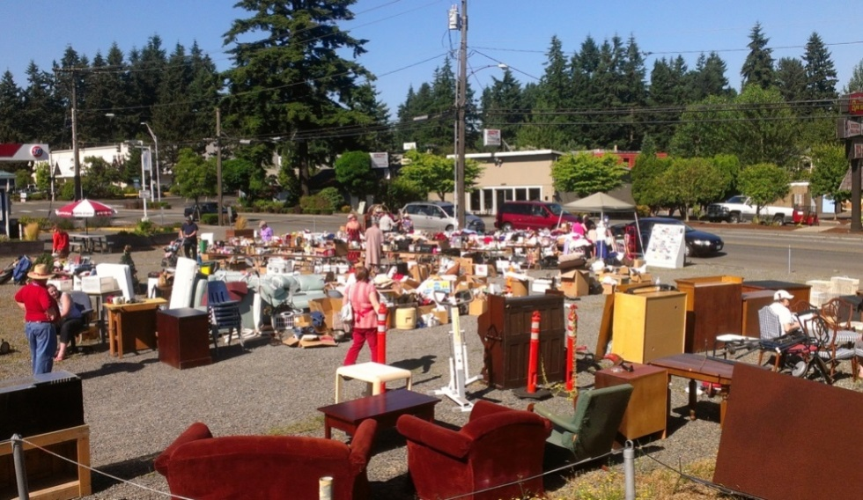
Temporary Uses such as Sidewalk Sales and Farmers Markets
Temporary uses
Temporary permit (Minor use permit )
Allow for up to 180 days per year, up to 3 years
Allowed in all zone districts
35% of parking lot, max.
Seasonal sales (e.g. pumpkins)
exempt from permit requirement,
subject to special site standards
and limited hours

Slide 21
Temporary Storage Structures (PODS) - New
Temp Structures
All zone districts
One POD-type storage structure allowed by right for up to 90 days.
Longer periods allowed with a Temporary Permit (MUP)
5 foot setbacks required.
Driveway location OK.
Allowed in the right of way with approval from Public Works.
Not allowed on vacant residential parcels, except with active building permit.

Slide 22
Temporary Tent Structures - New
Temp Structures
All zone districts
One tent structure up to 300 sq ft. allowed for 6 months.
With Temporary Permit can remain up to 1 year and can >300 sq ft.
Allowed in driveway
Standard setbacks apply except:
Open-sided tent structures qualify for reduced setback
5-ft from front and street side property lines

Slide 23
Cargo containers as Accessory Structures in all Zone Districts - New
Minor Use Permit required
Same size and use limits as standard accessory structures
Residential/ Ag: Not allowed on vacant res. parcel or in USL/RSL
Commercial only: Allowed in USL/ RSL
Screened from view or designed for neighborhood compatibility
Can be used as habitable accessory structures, with design review

Slide 24
Revised Permit Process for Residential Accessory Structures
Revise permit process for residential accessory structures, to allow more flexibility and more functional structures:
For habitable accessory structures in urban areas, do not require discretionary permit if within zoning district height limit (currently requires public hearing permit if over 17’)
For habitable accessory structures outside urban areas, allow 1,000 sq ft. and zoning district height limit without discretionary review (currently requires public hearing to exceed 640 sq ft or 17’ height)
Allow shower or bathtub in habitable accessory structures “by right” (currently not allowed)
Allow toilet with building permit (currently requires discretionary permit)
Limits on structures with shower or bathtub, and/ or toilet:
Parcels less than 10 acres, limit of one structure
Parcels 10 acres or larger, limit of 2 structures.

Slide 25
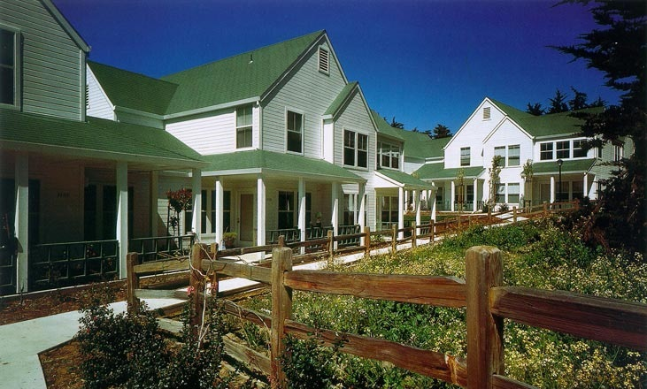
Revise site standards for multi-family zone district, to make the construction of multi-family housing feasible:
Accessory and Multi-family standards
Extend 3-story, 35 ft height limit allowed for affordable multi-family housing to all multi-family housing
Revise Floor Area Ratio standard to facilitate multi-family housing

Slide 26
For more information:
Review handouts provided
For complete information on the content of the code modernization proposal, visit Website at www.sccoplanning.com
On website, review previous Board letters, current drafts, and find out about upcoming meetings and hearings
Sign in to receive emails about future meetings and hearings.
Next steps: EIR and ordinance draft, public meetings before Planning Commission and Board of Supervisors in 2016
Thank you!

