Slide 1
CODE MODERNIZATION PROPOSAL Overview for Community Meetings
Updating the Permit Processing Framework
Agricultural Regulations
Wineries and Breweries
Temporary uses and structures
Limits to weddings on residential property
Revisions to site standards for multi-family zone district
Revisions to permit process for accessory structures

Slide 2
Structure of the Presentation
Overview
Overview of Draft Code Modernization Proposal
History of the Project
Permit framework
Agricultural regulations, including wineries and breweries
Updating other policies and code provisions
Detailed review of proposal for weddings, community events, and temporary permits
Next steps
Questions and comments?

Slide 3
Why Update Land Use Regulations?
Overview
Difficulties for individual permit applicants:
Confusing and complicated permit framework with different interpretations
Expensive and lengthy permit reviews with uncertain outcomes
Outdated regulations for agricultural properties
Unnecessarily complex permit process for some projects, e.g.:
Small agricultural greenhouse, new commercial tenant, new apartment building
Resulting in difficulties for the community:
Widespread illegal construction that may be unsafe, or may not comply with site standards or environmental regulations
Lack of community investment - housing and jobs
Goals: Straightforward regulations that all can be understood by all, with complete, consistent and efficient review of applications.
Revise outdated regulations
Continue to protect the environment and the quality of neighborhoods.

Slide 4
What is Code Modernization?
Overview
Modernize and Standardize the Permit framework, use clear nomenclature
Update regulations for agricultural uses to support local commercial agriculture, breweries and wineries
Update list of uses allowed in zone districts, with appropriate reviews for different project types
Add language lacking in current code to regulate:
Limit commercial weddings on residential property
Community events
Newer types of temporary structures, such as PODS and light-frame tent structures
Revisions to site standards for the Multi-family zone district and to permit requirements for accessory structures
Maintain regulations protecting the environment and neighborhood quality

Slide 5
Code Modernization: Development of the draft proposal
Overview
Board of Supervisors Initiates Code Modernization Proposal
May 19, 2015: Board of Supervisors accepts draft language for permit framework and agricultural regulations for environmental review
COMMUNITY MEETINGS 9/9 through 9-16
Overview of Code Modernization Proposal
Detailed review and input: Weddings, community events, and temporary permits
June 9, 2015: Board of Supervisors considers draft language for weddings and community events on residential parcels, Temporary Permits, requests community meetings
NEXT STEPS:
Sept. 29: Board of Supervisors Meeting to consider revised proposal for weddings, community events, and temporary uses
Prepare Environmental Impact Report (EIR) on Modernization Proposal
Public review and comment, meetings, and hearings on Draft EIR and Code Modernization
Notes:
.

Slide 6
Permit Processing Framework
Permit Framework
Introduce separate permits for uses (“Use permit”) and physical site development (“Site development permit”)
Allow principal permitted uses, where compatible with the zone district (professional office, retail)
Use standard, descriptive terms for permits and processes (e.g. “Conditional Use Permit”, “Minor Site Development permit”) in place of “levels”
Clarify which permits are subject to environmental review (“discretionary” vs. “ministerial”)

Slide 7
New Permit Terms
Permit | Public Notice | Decision Maker | Discretionary or Ministerial
Zoning Clearance (ZC) | No | Planning Director | Ministerial
Minor Use Permit (MUP) | No | Planning Director | Discretionary
Administrative Use Permit (AUP) | Yes | Planning Director | Discretionary
Conditional Use Permit (CUP) | Yes | Public Hearing | Discretionary

Slide 8
PERMIT NAMES, CURRENT AND PROPOSED
PERMIT DECISIONS BY PLANNING DIRECTOR OR DESIGNATED STAFF
Current Code | Permit Name In Proposed Code | Type of Action | Public Notice | Public Hearing | Who Decides Appeals, Who May Appeal
Level I, Level II | Zoning Clearance (ZC) Environmental Clearance (EC) | Ministerial | No | No | Planning Director, Applicant / Owner
Level III | Minor Permit MUP, MSP | Discretionary | No | No | Zoning Administrator, Any party
Level IV | Administrative Permit AUP, ASP | Discretionary | Yes | No | Zoning Administrator, Any party
PERMIT DECISIONS BY ZONING ADMINISTRATOR
Level V | Conditional Permit CUP, CSP | Discretionary | Yes | Yes | Planning Commission, Any party
PERMIT DECISIONS BY PLANNING COMMISSION
Level VI | Conditional Permit CUP, CSP | Discretionary | Yes | Yes | Board of Supervisors (jurisdictional hearing), Any party
PERMIT DECISIONS BY BOARD OF SUPERVISORS
Level VII | Tentative Maps Legislative Matters | Discretionary | Yes | Yes | No Appeal (Court challenge is next step)

Slide 9
Update Policies to Support Local Agriculture
Agriculture
Update policies to support diverse needs of local agriculture, from small diversified farms to large farming operations spread over multiple parcels, as identified in meetings with Farm Bureau, APAC
Accommodate the need for more agricultural support infrastructure such as agricultural research and development, as identified in the 2014 Economic Vitality Study
Recognize that activities such as on-farm retail and agricultural services (equipment repair, delivering agricultural products, and equipment storage) are needed to support the basic farm activities of producing food, fiber and livestock, and are part of agriculture use sector
Support agricultural employee housing consistent with state law
Protect agricultural land and the viability of commercial agriculture consistent with Measure J
s

Slide 10
Proposal Implements “Measure J” Policies
Agriculture
Text from Measure J (SCCC Chapter 17.01, Growth Management)
Findings. “Loss of Agricultural Lands. The County possesses significant agricultural lands, including prime agricultural lands, and agricultural lands which, while not defined as “prime,” are economically productive or potentially economically productive. Such agricultural lands are a local, State and national resource, which should be preserved. These agricultural lands are being lost to development, and the continued viability of commercial agriculture in Santa Cruz County is threatened by rapid population growth and inappropriately placed development.”
“Preserve Agricultural Lands. It shall be the policy of Santa Cruz County that prime agricultural lands and lands which are economically productive when used for agriculture shall be preserved for agricultural use.”
Agricultural update implements Measure J:
Updated regulations to support viable local agriculture, as identified by the
Farm Bureau
Maintains existing restrictions against converting agricultural land to other uses (residential or commercial) to protect farmland
Continues to prohibit subdivisions on CA land for non–agricultural purposes
Preserves agricultural land thru siting requirements, discretionary permits.

Slide 11
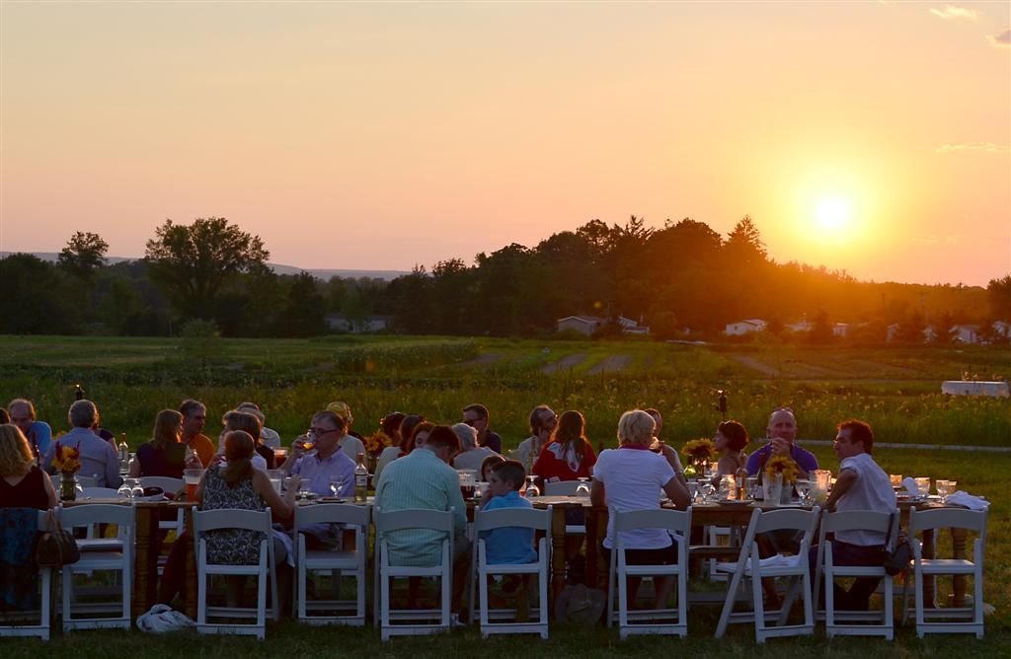
Modern Uses Added In Agricultural Districts
Agriculture
Agritourism and Education (such as farm dinners, school visits)
Produce markets (subject to discretionary permit, local inventory requirement, and size limit)
Farmstay/Homestay (up to 6 guest rooms in residential buildings that are already allowed by the code, criteria to prevent “motels”)
Research and Development (ancillary to farming, subject to discretionary permit over 2500 sq ft, criteria to minimize disturbance and protect type I-III soil

Slide 12
Additional Updates for Agriculture
Agriculture
Incorporate State law that requires housing for agricultural employees to be treated as an agricultural use - up to 12 units/36 beds “by right.”
Allow Consideration of > 12 units/ 36 beds with discretionary permit and CEQA Review
Subject to Planning Commission public hearing, siting criteria, and limits on project size as needed to protect agricultural soils
Allow ADUs on CA and A “by right”, as allowed throughout the County wehre there is a principal single family home
Broaden the agricultural services and support activities allowed on CA and A, such as farm equipment repair, subject to discretionary permits and CEQA review, with criteria and findings to protect agricultural land, such as:
Avoiding/minimizing disturbance of Type l-lll soil,
Alternatives siting analysis for larger projects
Simplify greenhouse regulations

Slide 13
Wineries And Breweries
Wineries
Issue with Current regulations:
Lack of standards for wineries, especially for tastings and events, leads to varying outcomes.
Standards for wine tastings are difficult to enforce.
Goals of revised regulations:
Provide standards in code to support local wineries and breweries, allow on-site marketing necessary to many local operations
Protect residential neighborhoods and agricultural land from potential impacts.

Slide 14
Wineries and Breweries – Revised Standards
Wineries
Continue to allow wineries in CA, A, RA and RR zonings*
Continue to require discretionary permit for all new wineries
New standards for promotional events, indoor and outdoor tasting, and other gatherings, subject to criteria and findings to standardize permit reviews
Size of structures, number of events, numbers of guests, and music are addressed
Special limits apply for wineries in the RA and RR zone districts, including event hours and numbers of guests, to protect neighboring parcels
On agricultural sites, winery or brewery must be secondary to agricultural use, and sited to protect agricultural soil
Permit with neighborhood notice required for outdoor amplified music
Weddings at wineries/ breweries require separate CUP approval, neighborhood meeting
* Also allowed in industrial, manufacturing and commercial zones

Slide 15
Wineries
SUMMARY OF STANDARDS FOR WINERIES AND BREWERIES
Size, based on production | Small Up to 10,000 gals, 3,000 barrels | Medium 10-30,000 gals, 6,000 barrels | Large >30,000 gals, >6,000 barrels
Permit required – CA and A | MUP/ MSP | AUP/ ASP | CUP/ CSP
Permit required – RA and RR | AUP/ ASP | CUP/ CSP | Not Allowed
Zone Districts (same as current) | RR, RA, A, CA CA: ancillary, protect ag soils | RR, RA, A, CA CA: ancillary, protect ag soils | A, CA CA: ancillary, protect ag soils

Slide 16
Wineries
SUMMARY OF STANDARDS FOR WINERIES AND BREWERIES, part 2
Marketing Events, Indoor (tastings, classes) | RA , RR or w/in 200’ of a parcel with a residence: 11:00 AM - 6:00 PM A, CA: 11:00 AM - 9:00 PM CUP required for extended hours
Marketing Events, Outdoor (small) (Such as tastings, and tours) | RA , RR or w/in 500’ of a parcel with a residence: Up to 25 guests, 11:00 AM - 6:00 PM (extended hours req’s CUP) Up to 50 guests with CUP A, CA: Up to 50 guests, 11:00 AM - 6:00 PM
Marketing Events, Outdoor (large) (>50 guests) (Passport Days) | 10 events 11:00-9:00 P CUP for > 10 | 16 events 11:00-9:00 PM CUP for > 10 | 20 events 11:00-9:00 PM CUP for > 10
Maximum Number of Guests at events | Specified by the use permit, considering site characteristics: road access, parking, proximity to residences, noise issues
Outdoor amplified music | Amplified music permit required. - noticed, discretionary

Slide 17
Commercial Weddings Secondary to a Residential Use
Weddings
GOAL: Limit commercial weddings on residential parcels, with standards to protect adjacent residences
Standards:
Allow only in rural areas outside the Coastal Zone, in the RA and RR zone districts
Always requires CUP and neighborhood meeting
Minimum parcel size of 8 acres to buffer from neighbors
Permit conditions establish maximum number of guests, events per year, wedding hours, limitations on outdoor music, as appropriate to the site and in response to neighborhood concerns
Required to provide for parking, emergency vehicle access, sanitation facilities and litter control
Must conform to noise limits in General Plan
Permit renewal required after 5 years

Slide 18
Community Events and Fundraisers on Private Residential Property
Community Events
GOAL:
Provide streamlined review process for community events and fundraisers on private residential property, while providing standards and appropriate reviews to protect neighboring properties
Example: Bonny Doon Art and Wine Festival
STANDARDS:
Allow in residential areas county-wide
One event requires a zoning clearance
Parking on or off-site required
Provide sanitation, control litter
Clearance by Fire Department, other agencies
Two or more events per year requires minor use permit
Permit conditions limiting event hours, frequency, outdoor amplified music, appropriate to the site and location
Renewal of minor use permit required every 5 years

Slide 19
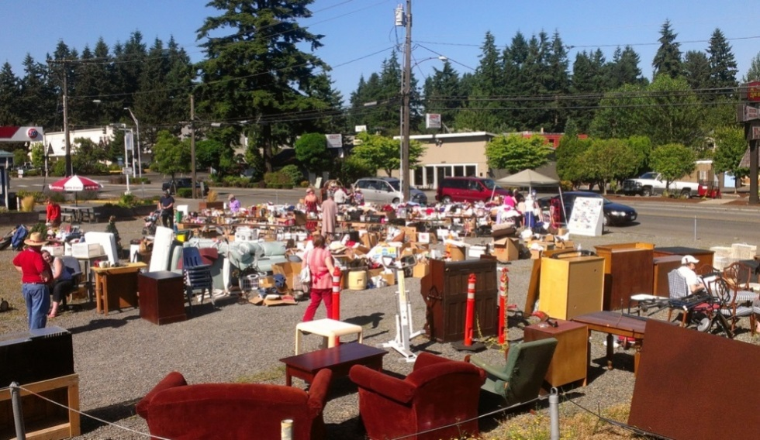
Temporary Uses such as Sidewalk Sales and Farmers Markets
Temporary uses
Temporary permit (Minor use permit )
Allow for up to 180 days per year, up to 3 years
Allowed in Commercial and Industrial districts
35% of parking lot, max.
Seasonal sales (e.g. pumpkins)
exempt from permit requirement,
subject to special site standards
and limited hours

Slide 20
Temporary Storage Structures (PODS) - New
Temp Structures
One POD-type storage structure allowed by right for up to 60 days.
Up to 180 days allowed with a Temporary Permit (MUP)
5 foot setbacks required.
Driveway location OK.
Allowed in the right of way with approval from Public Works.
Not allowed on vacant residential parcels, except with active building permit.

Slide 21
Temporary Tent Structures - New
Temp Structures
One tent structure up to 300 sq ft. allowed for 6 months.
With Temporary Permit can remain up to 3 years and can >300 sq ft.
Allowed in driveway
Standard setbacks apply except:
Open-sided tent structures qualify for reduced setback
5-ft from front and street side property lines

Slide 22
Cargo containers as non-habitable accessory structures, on rural parcels only - New
Accessory and Multi-family standards
Not allowed on vacant residential parcel or in USL/RSL
Screened from view or designed for neighborhood compatibility
Only one container per parcel
Minor Use Permit required
Same size and use limits as standard accessory structures

Slide 23
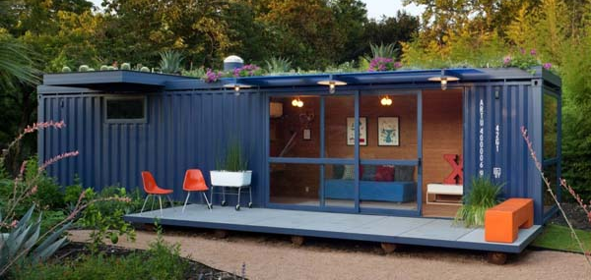
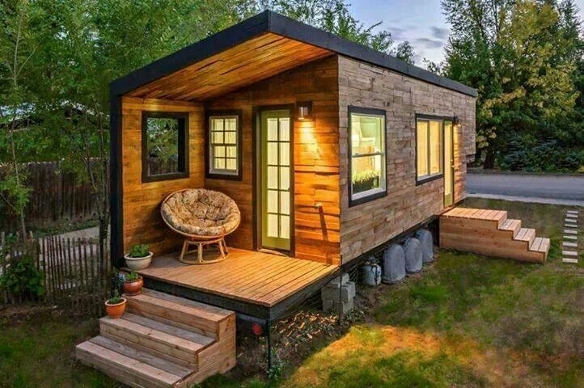
And as habitable accessory structures
Accessory and Multi-family standards
Not within Urban/ Rural Service Areas
Meet site standards for habitable accessory structures
In addition:
Siding required, must reach to foundation.
Design, color and materials to complement existing buildings.

Slide 24
Revised Permit Process for Accessory Structures and Site Standards for Multi-family zone districts
Accessory and Multi-family standards
Revise permit process for residential accessory structures, to allow more flexibility and more functional structures:
For habitable accessory structures in urban areas, do not require discretionary permit if within zoning district height limit (currently requires public hearing permit if over 17’)
For habitable accessory structures outside urban areas, allow 1,000 sq ft, 28 ft without discretionary review (currently requires public hearing to exceed 640 sq ft or 17’ height)
Allow shower or bathtub in non-habitable accessory structures “by right” (currently not allowed)
Allow toilet with building permit (currently requires discretionary permit)

Slide 25
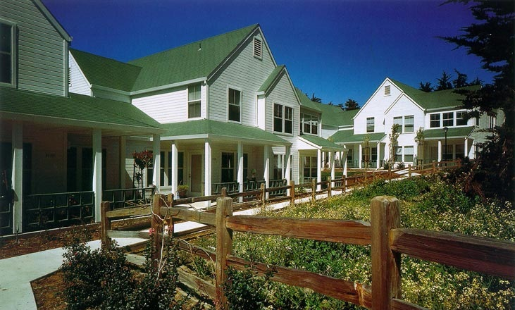
Revise site standards for multi-family zone district, to make the construction of multi-family housing feasible:
Accessory and Multi-family standards
Extend 3-story, 35 ft height limit allowed for affordable multi-family housing to all multi-family housing
Revise Floor Area Ratio standard to allow multi-family housing

Slide 26
Code Modernization: Development of the draft proposal
Overview
Board of Supervisors Initiates Code Modernization Proposal
May 19, 2015: Board of Supervisors accepts draft language for permit framework and agricultural regulations for environmental review
COMMUNITY MEETINGS 9/9 through 9-16
Overview of Code Modernization Proposal
Detailed review and input: Weddings, community events, and temporary permits
June 9, 2015: Board of Supervisors considers draft language for weddings and community events on residential parcels, Temporary Permits, requests community meetings
NEXT STEPS:
Sept. 29: Board of Supervisors Meeting to consider revised proposal for weddings, community events, and temporary uses
Prepare Environmental Impact Report (EIR) on Modernization Proposal
Public review and comment, meetings, and hearings on Draft EIR and Code Modernization

Slide 27
COMMUNITY MEETINGS

Slide 28
For more information:
Next steps
Review handouts provided
For complete information on the content of the code modernization proposal, visit Website at www.sccoplanning.com
On website, review previous Board letters, current drafts, and find out about upcoming meetings and hearings
Attend the Board of Supervisors meeting on Sept. 29th
Thank you!

